Slide 1
DAB-402: Capstone Project
COVID-19 Forecasting & X-Ray Image detection
Group: 7
GitHub - https://github.com/PradeepKTomar/COVID-19-Forecasting-and-Ultrasound-Image-detection

Slide 2
Group members
Akash Sharma
Aleena Almeida
Faizal Kazi
Jay Patel
Pradeep Tomar

Slide 3
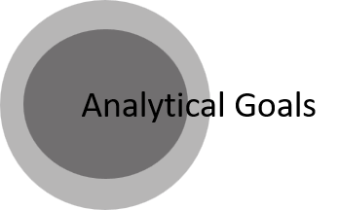
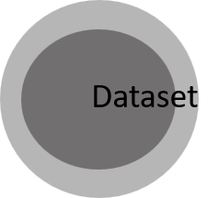
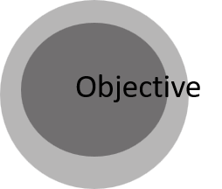
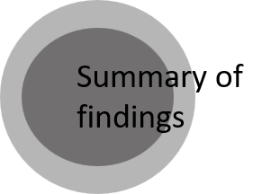
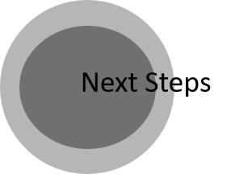
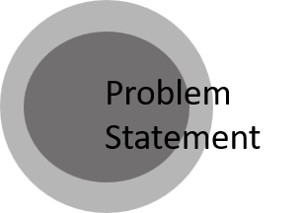
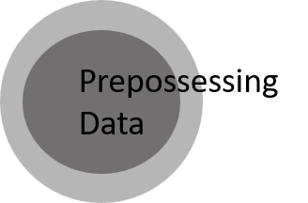
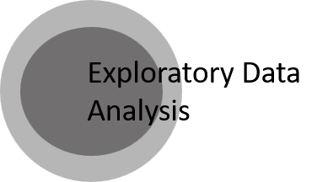
Contents

Slide 4
Problem Statement
The COVID-19 pandemic has become one of the biggest public health crises of our time, affecting millions of people worldwide.
The virus can be detected by taking nose and throat swabs which is highly expensive. A self-diagnosis kit is also available, but they are not 100% reliable. RT-PCR test take up to 24 hours to return results. Another fast test is Antigen, but the accuracy of this test varies.
The virus still exists, and no fast and accurate diagnostic is available to the public.

Slide 5
Objectives
The objective of this project is to develop a reliable and accurate forecasting and prediction model for COVID-19 which will forecast the number of cases according to region, and predict if the patient has covid or not by analyzing the image data.
The idea is to build a machine learning model based on time series prediction to determine which country will have an impact in the year 2023.
The project aims to provide valuable insights and information which will help to take decisions and take proactive measures to control the spread of COVID-19.

Slide 6
Analytical Goals
The main goal is to construct an analytical model that can reliably categorize these photos into COVID or NORMAL categories, and potentially help in the prediction of covid.
Achieve high accuracy to classify images into two categories (COVID & NORMAL) using CNN model.
Evaluate various metrics like accuracy, recall, and F1 score to better understand the classifier's performance.

Slide 7
Dataset
The Corona Virus Pandemic which is an open-access dataset was consolidated by the University of Oxford. We were able to locate this data on Kaggle.
Data source: https://www.kaggle.com/datasets/georgesaavedra/covid19-dataset
X-Ray data- https://www.kaggle.com/code/vivek468/chest-x-ray-covid-classification-keras

Slide 8
Preprocessing
Removed images that are of poor quality or contain artifacts or artifacts, resized all images to a standardized resolution.
Extracted relevant features such as shape, pixel texture from the lung X-ray images.
Reduced the dimensionality of the feature vectors to avoid overfitting and improve the model's performance.

Slide 9
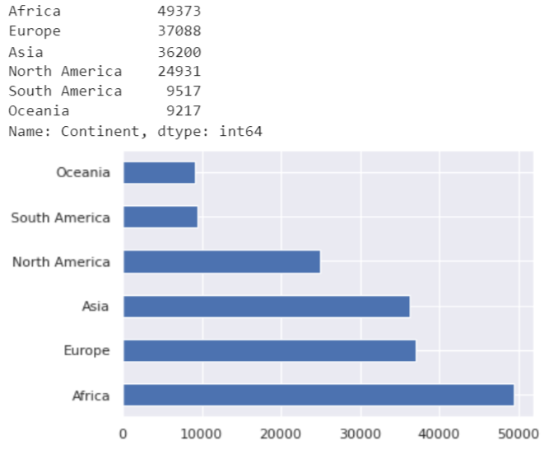
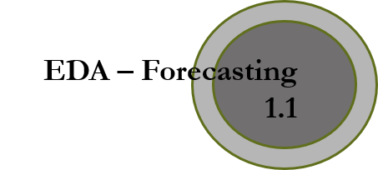
Exploratory Data Analysis
The cases have been divided by Continent, and Africa is having the most number of cases from March 2020 – March 2022 followed by Europe and Asia
Covid cases by Continent

Slide 10
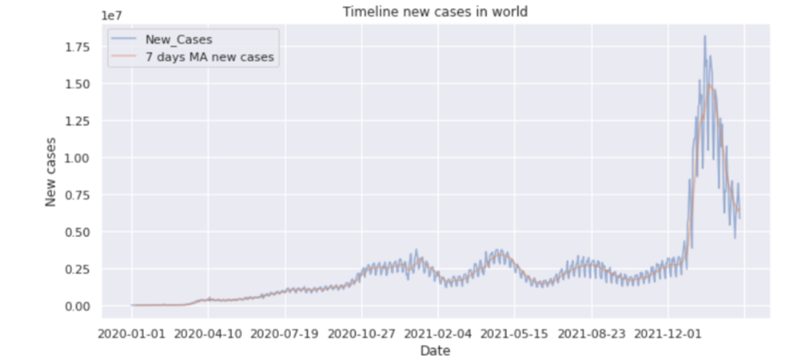
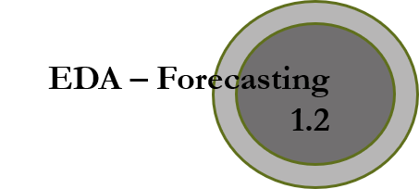
In order to remove noise, a 7 day moving average was taken.
Timeline of new cases in the world

Slide 11
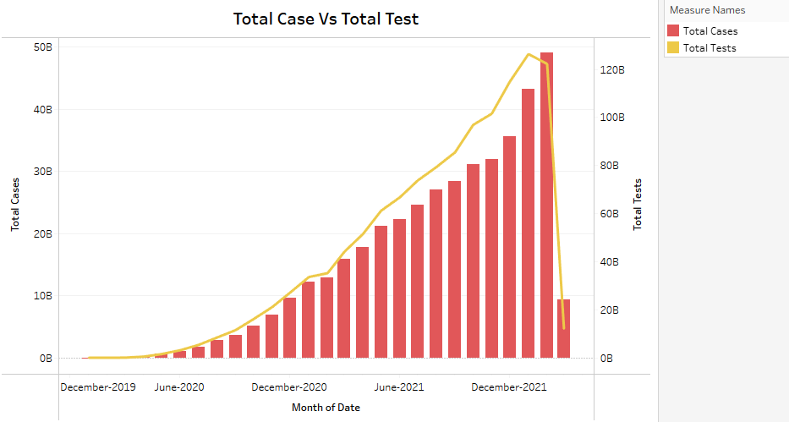
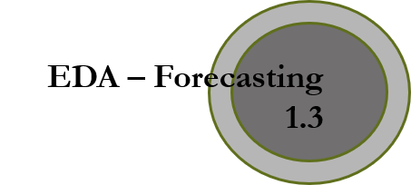
The total tests conducted and total cases were similar till June 2021 in all the continents.
Later, the ratio of total tests conducted boomed in June 2021 till December 2021 with respect to the average number of total cases for all the continents.
Higher the number of tests per patient conducted, greater will be the possibility for life expectancy.
Total cases vs Total tests

Slide 12
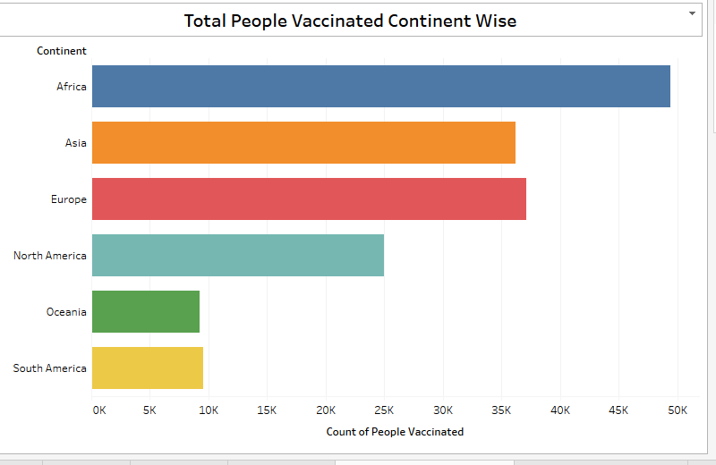
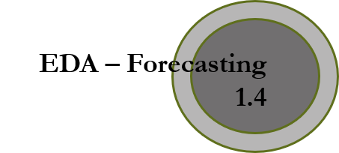
Africa has the maximum number of vaccination rate which is nearly about 50,000.
Asia and Europe have been conducting the vaccinations nearly at a similar pace.
Oceania has the lowest number of vaccinations among all the continents which is about 9,000.
Continent wise Vaccination

Slide 13
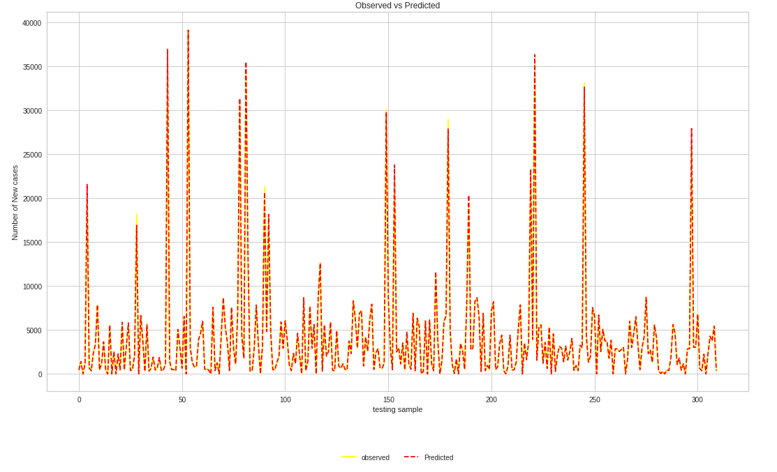
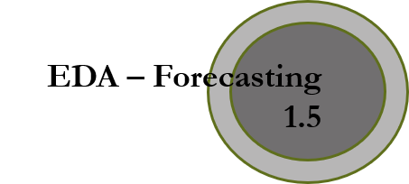
Forecasting using Random Forest

Slide 14
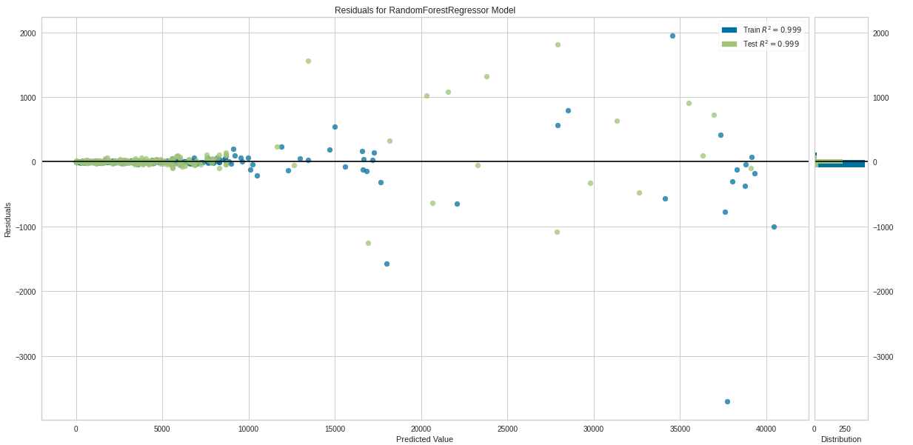
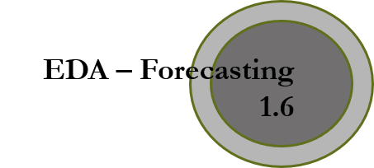
R square for train and test is 0.99

Slide 15
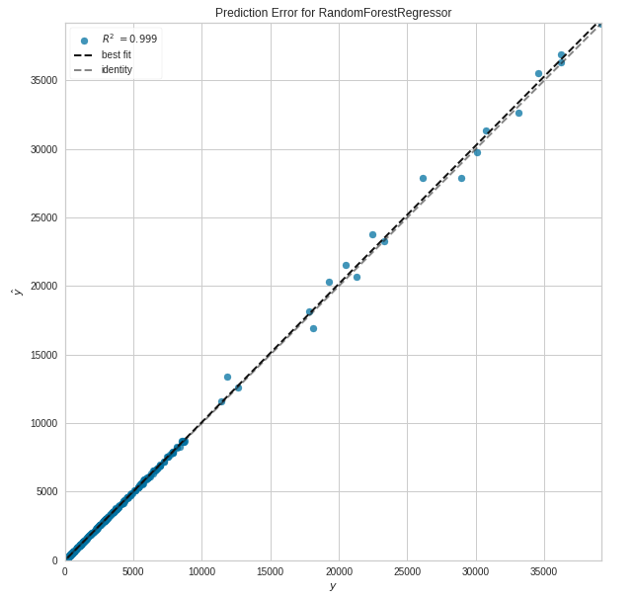
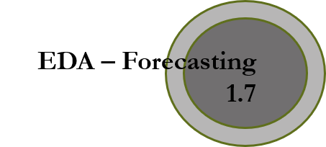
Cross-validation scores: [0.977 & 0.977]
Accuracy = 0.9987

Slide 16
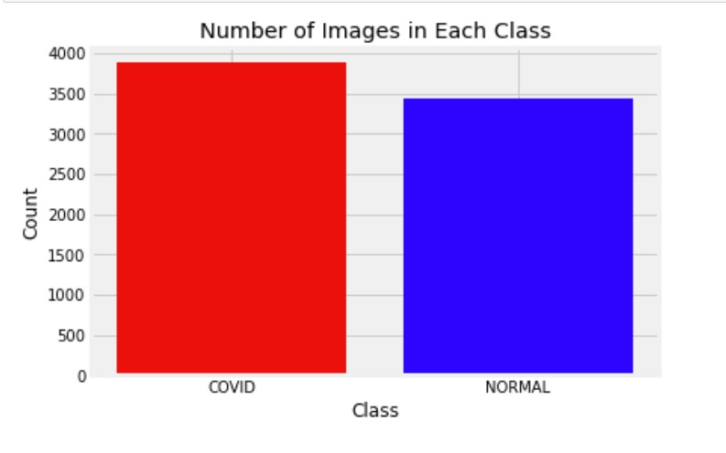
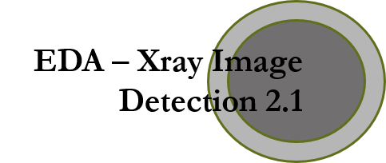
There are 3800 images of COVID class and 3400 images of NORMAL class.
There is difference of 400 images in both the classes.
Hence, both the classes are balanced.
Total images in each class

Slide 17
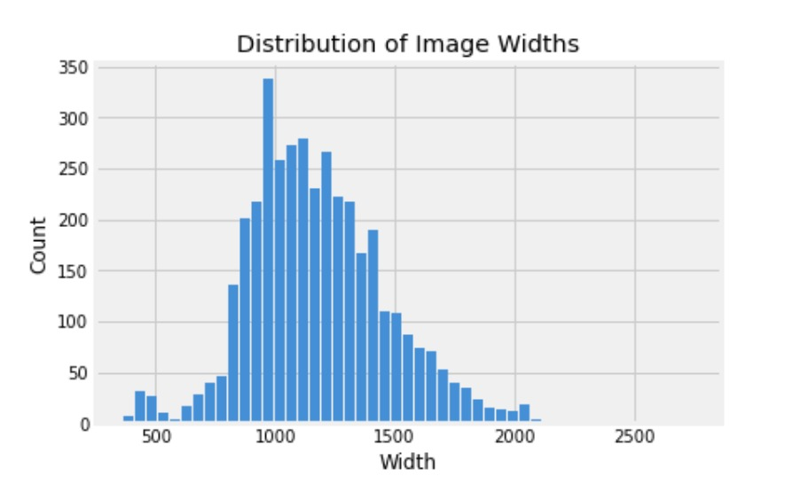
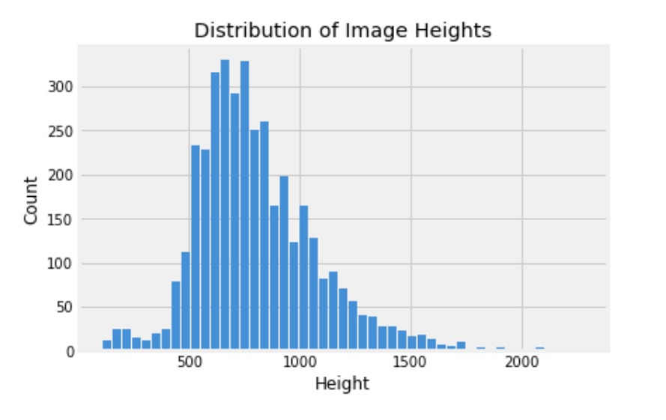
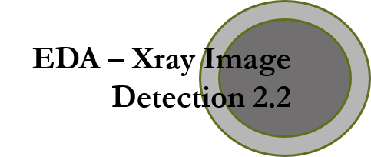
Height & Weight distribution in Images

Slide 18
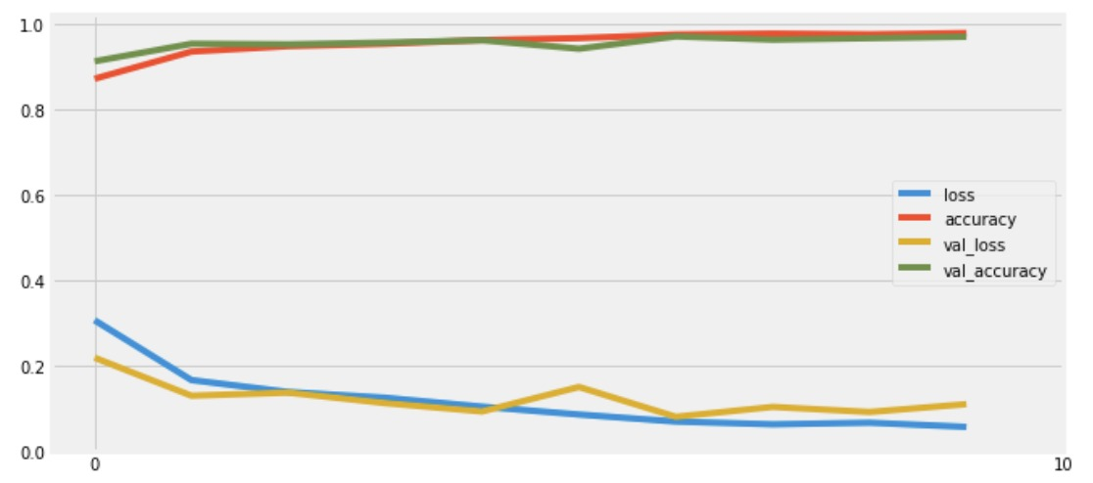
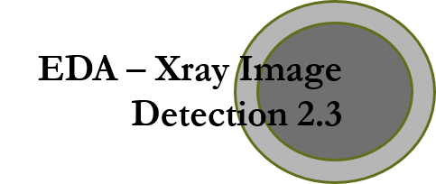
CNN Training – Loss & Accuracy
USING CNN WE GOT ACCUARACY OF 0.95%

Slide 19
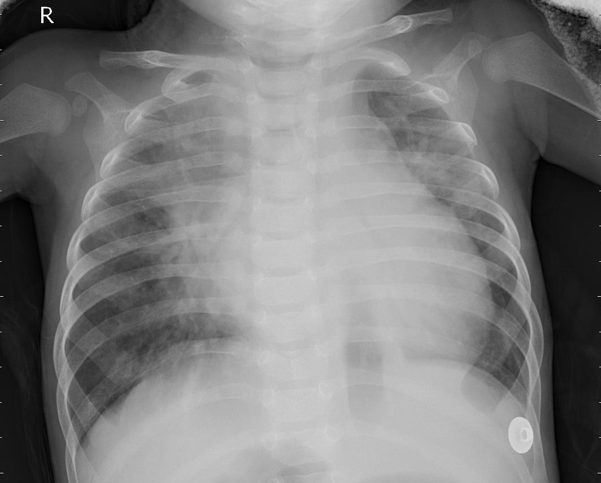
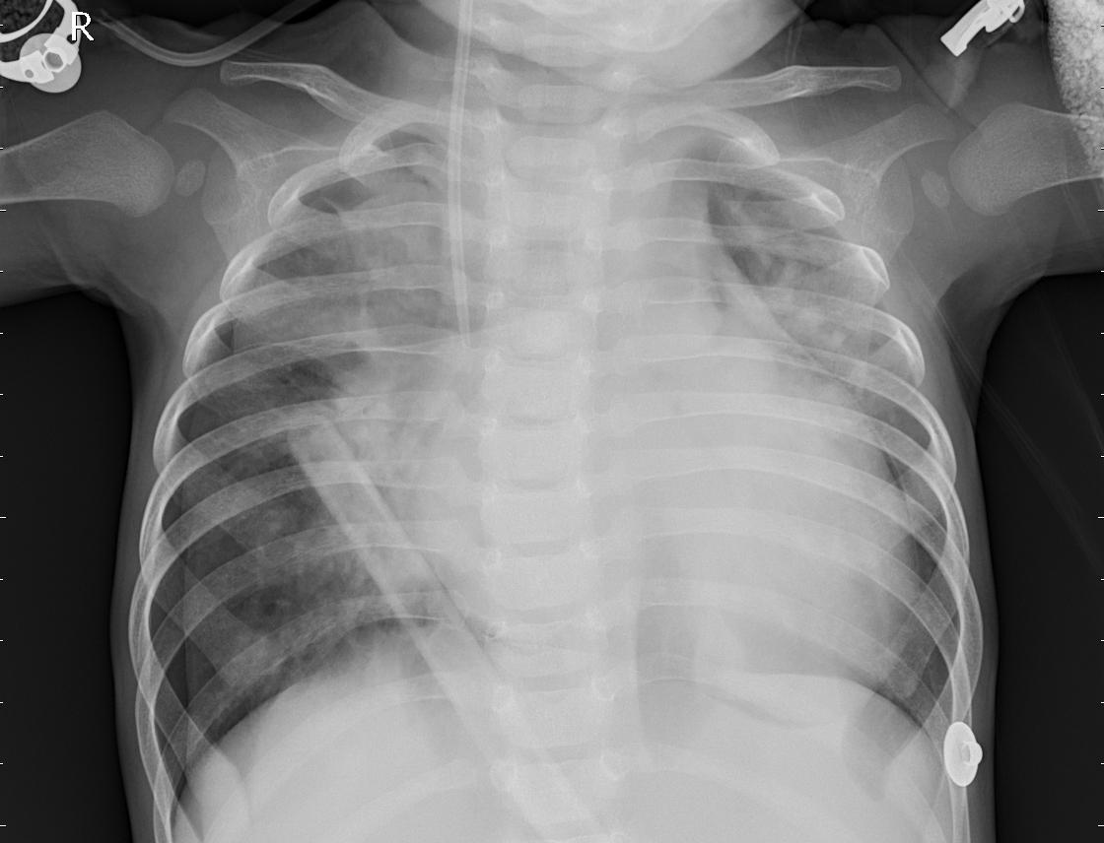
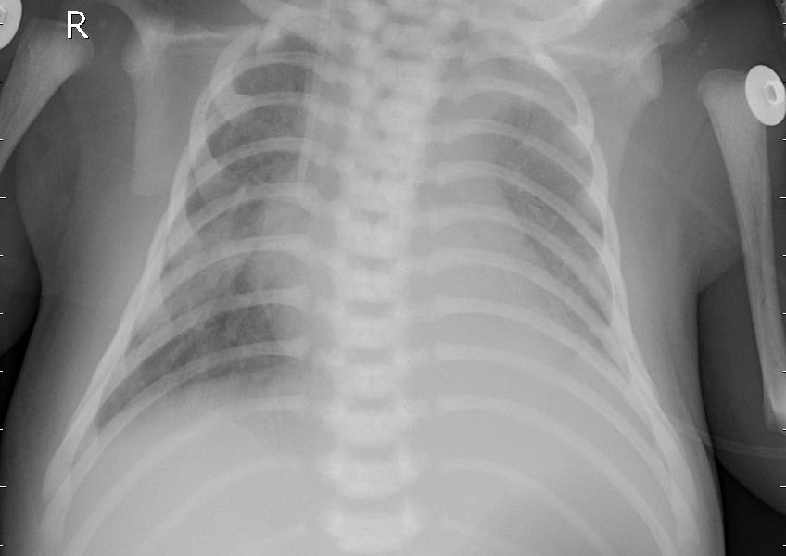

Dataset sample
It is not possible to detect Covid just by looking at the X-ray images. So, we need to build a CNN model to predict if the patient has covid or not. It would be a great assist for the doctor too.

Slide 20
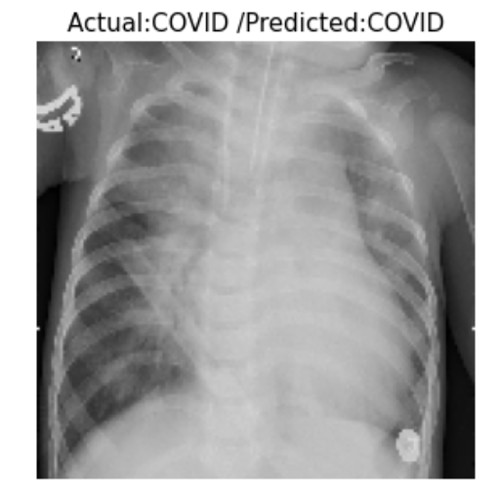
Expected outcome

Slide 21
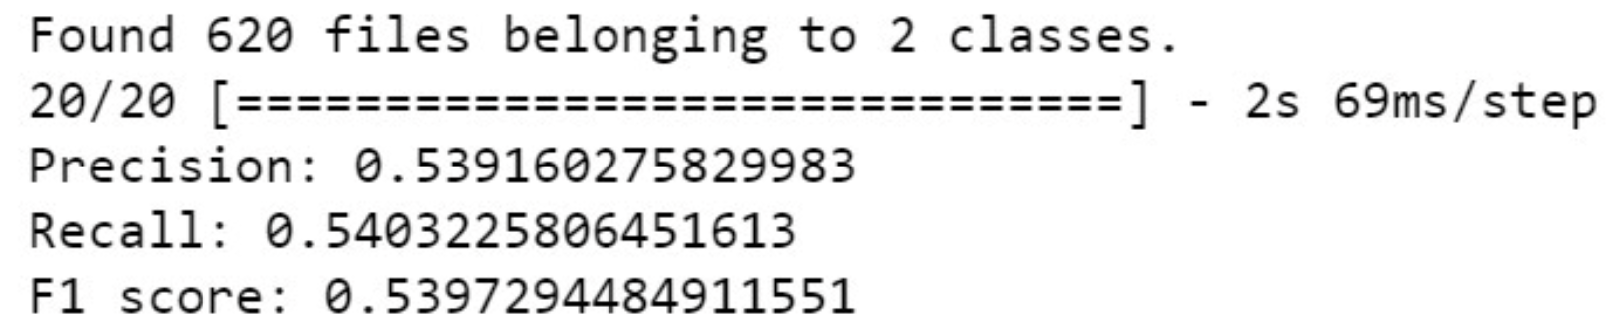
Summary of current findings
We got test accuracy of 0.95% for CNN model
We got Precision- 0.53%, Recall-0.54%, F1 Score: 0.53% respectively.

Slide 22
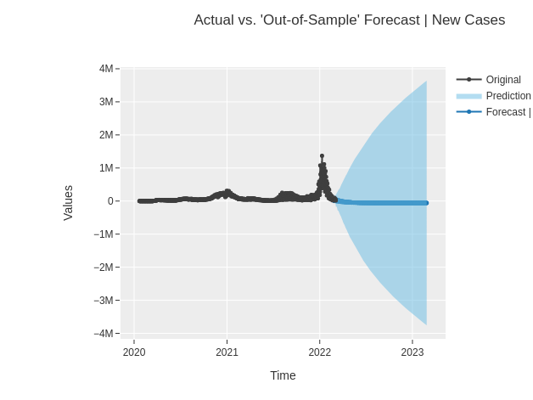
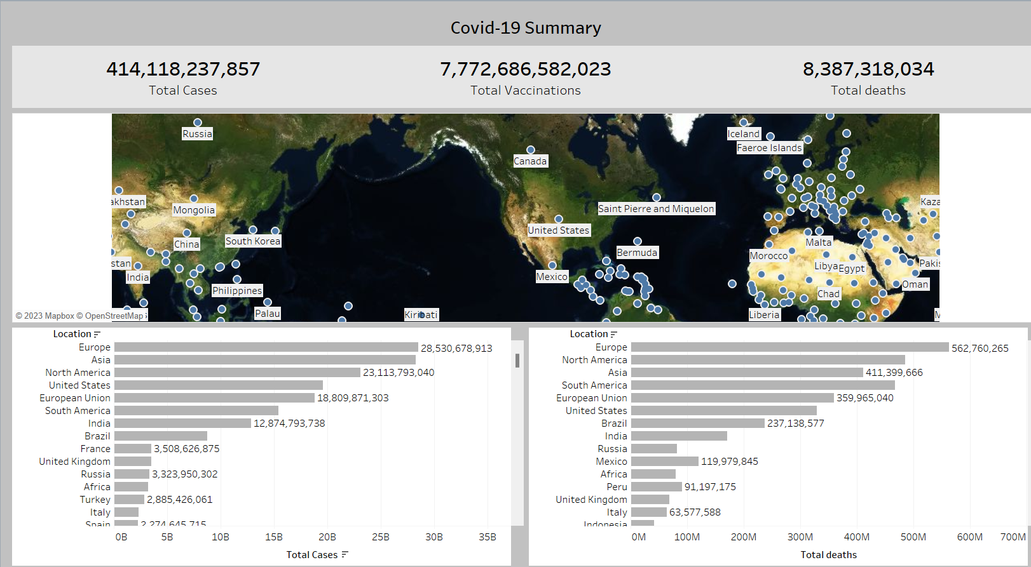

Next steps

Slide 23
Thank You

